Slide 1
Focused Clustering and Outlier Detection in Large Attributed Graphs
Author : Bryan Perozzi , Leman Akoglu , Patricia lglesias Sánchez ,
Emmanuel Müller
Advisor : Dr. Jia-Ling , Koh
Speaker : Sheng-Chih , Chu
From : ACM KDD‘14
Date : 2014/12/18

Slide 2
Preview
Introduction
FOUSCO Algorithm
Experiments
Conclusion

Slide 3
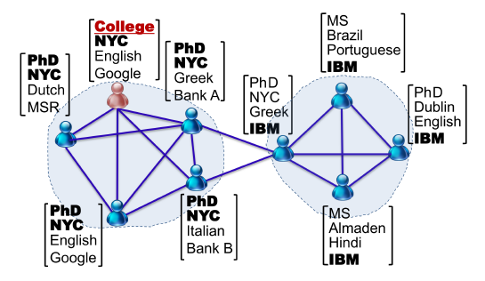
Introduction
Attributed Graphs
Each node has 1+ attribute
Ex: facebook user
Grade,Education,skin
Country,Language…
Transform a feature vector : f[]

Slide 4
Introduction
Many irrelevant attribute for most query
Focuse on some attribute , increase its attribute weight.
Problem
Efficientively identify user preference
Efficiently “chop out” relevant clusters locally with out necessarily partitioning the whole graph
And additionally spot outlier if any.

Slide 5
Introduction

Slide 6
Introduction
FOUSCO Algorithm
User input
C_{ex}
(exemlar
nodes)
Large Graph
G(V,E,F)
P1
Infer Attribute weight
P2
FindCoreSet
P3
EXPAND
P4
CONTRACT

Slide 7
FOUSCO Algorithm
Introduction
FOUSCO Algorithm
Experiments
Conclusion

Slide 8
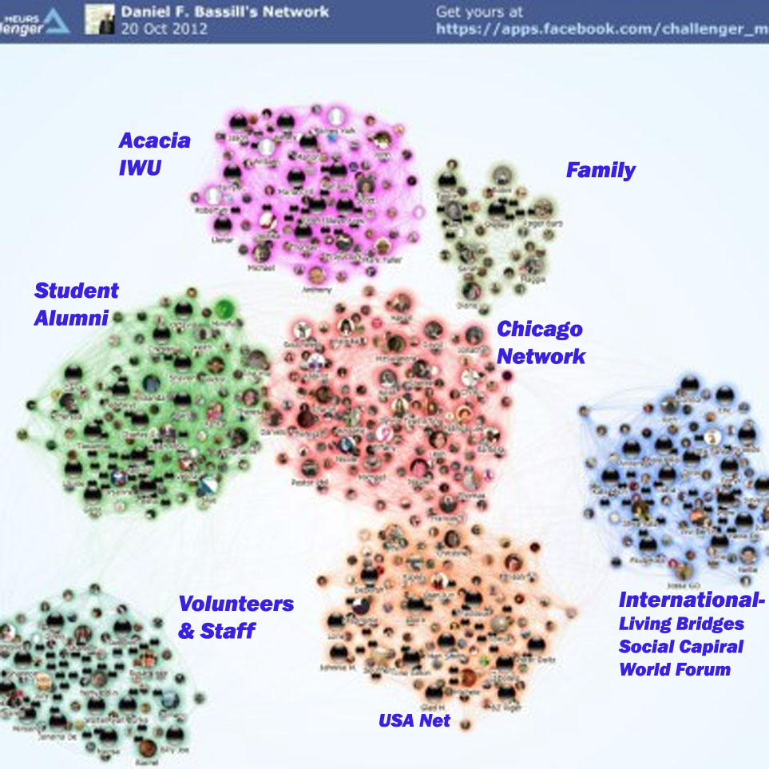
FOUSCO Algorithm
Given :
exemplar nodes set
Large Graph(V,E,F)

Slide 9
Algorithm (2)
P1:Find focused attribute
P2:Find CoreSet Growing
P3:EXPAND Coreset
P4:Outiler Dection

Slide 10
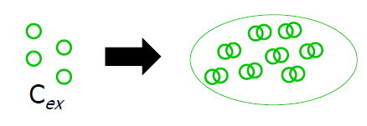
P1 : Infer Attribute weight(1)
Construct Similarity Pairs Set P_{s} : pairs of exemplar nodes
Construct Dissimilarity Paris Set P_{D} : Random sample(u),sample(v)
Learn a distance metric between Ps and Pd.

Slide 11
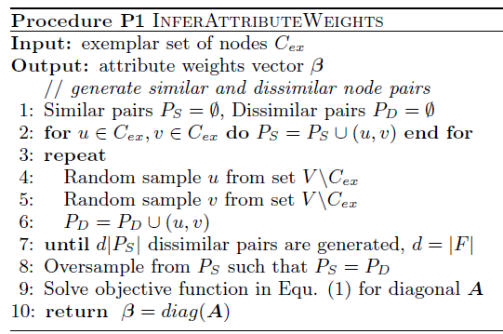
P1 : Infer Attribute weight(2)

Slide 12
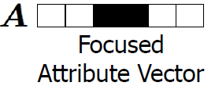
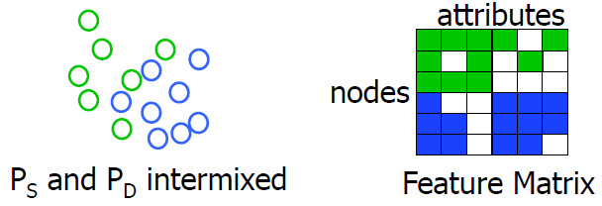
Distance Metric Learning
Notes:
曲線是弧形的

Slide 13
P2 : FindCoreSet
1. Rewrite all edge weight for Graph
2. Keep higher weight > = w’ (Find Top-K)
3.bulid subgraph(V’,E’,F) and return core set
W(I , j)

Slide 14
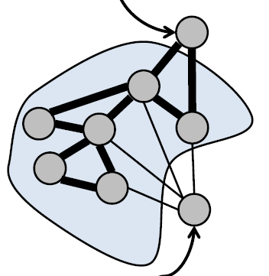
P3 : EXPAND(1)
First,Compute current weighted conductance
For each step add node decrease weighted conductance
For each n (nodes) in CandidateSet
if ∆φ^{w} ≤ φ_{best} Add node to bestStructureNode Set
Update φ_{best ,} φ_{cur} , Until Convergence

Slide 15
Weighted conductance
Asume all edge weight is 1.
Wout(C) = 8 , Wvol(C) = 11
W(I , j)

Slide 16
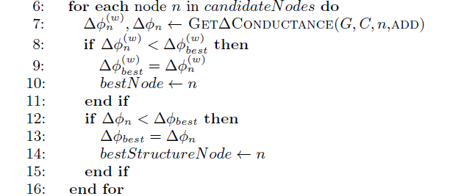
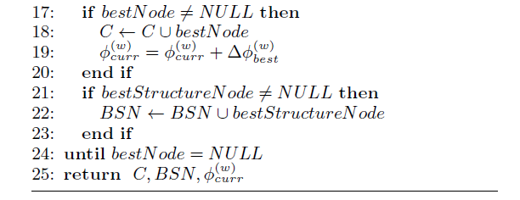
P3 : EXPAND(2)

Slide 17
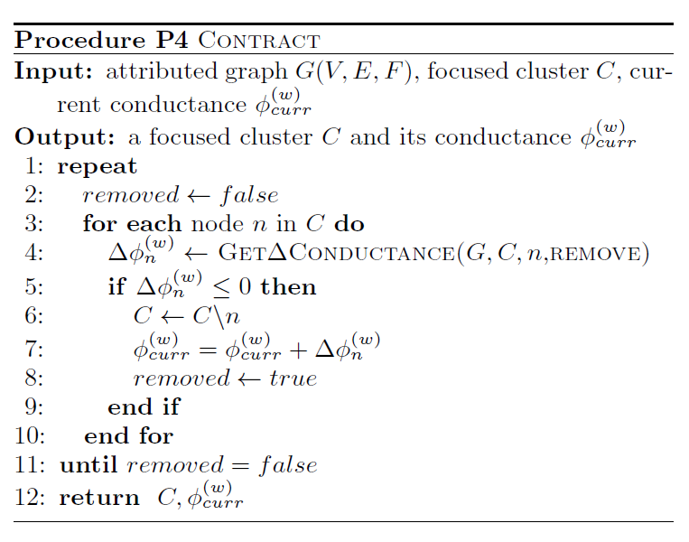
P4 : CONTRACT
Find Outiler :

Slide 18
Preview
Introduction
FOUSCO Algorithm
Experiments
Conclusion

Slide 19
Experiments
Data Gerneration(Synthetic) and RealWorld Graphs
Measures :
Cluster quality : NMI
Outlier accuracy : Precision , F1
Compare to :
CODA[‘10]
METIS[‘98]

Slide 20
NMI vs Attribute size |F|

Slide 21
Outlier Detection

Slide 22
Running Time

Slide 23
Conclusion
In this paper , Author introduces a new problem of finding focused clusters and outlier in large attribute graphs.
An efficient algorithm that infers the focus attributes of interest to the user , and extracts focused clusters and spots outliers simultaneously.

Slide 24
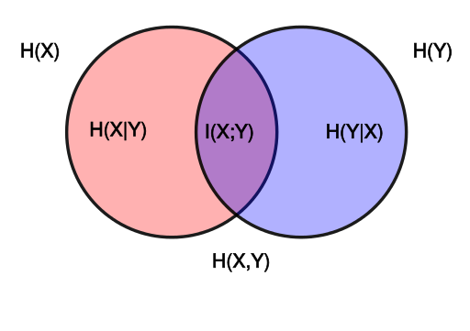
NMI
http://www.cnblogs.com/ziqiao/archive/2011/12/13/2286273.html

